Slide 1
Welcome to the NJDOE
Electronic Violence, Vandalism and Substance Abuse
Incident Reporting System (EVVRS)
2011-12 ONLINE TRAINING MODULE
This multimedia module follows the same steps outlined in the EVVRS Training Manual.
TO ENABLE THE TRAINING MODULE AUDIO AND HYPERLINKS,
YOU MUST ENTER THE “SLIDE SHOW” VIEW FROM THE TOOL BAR.
DATA ENTRY PROCEDURES
To advance to a specific topic, click on the corresponding hyperlink:
Part 1: Violence (including HIB), Vandalism and Substance Abuse (VV-SA) Incidents
Part 2: Suspension of Students with Disabilities for Other Reasons
Part 3: Editing Incident Reports
Part 4: Deleting Incident Reports
Part 5: Report Period 1 Official Submission
PLEASE TURN ON YOUR VOLUME TO HEAR THE TRAINING MODULE AFTER SLIDE ONE!

Slide 2
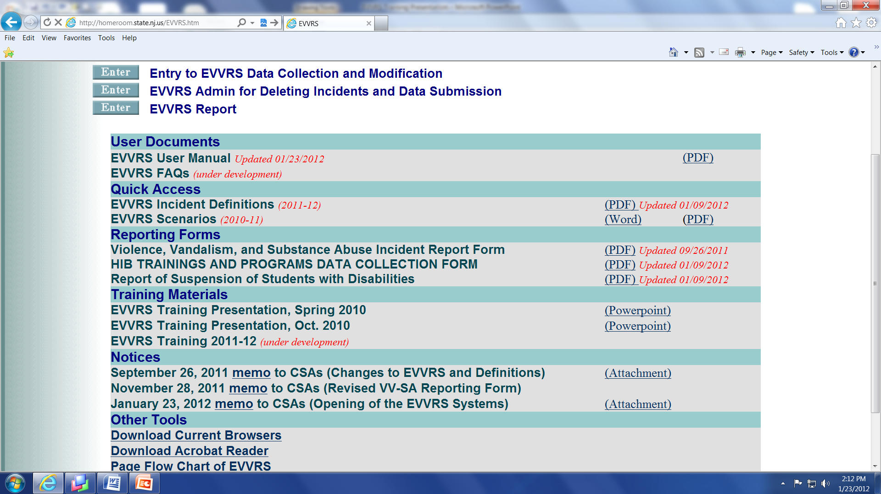

Slide 4
For login issues, please contact your district’s Web User Administrator. Each district’s Web User Administrator (usually the Business Administrator) establishes school and district-level user accounts for administrative and support staff that need access to the EVVRS.

Slide 7
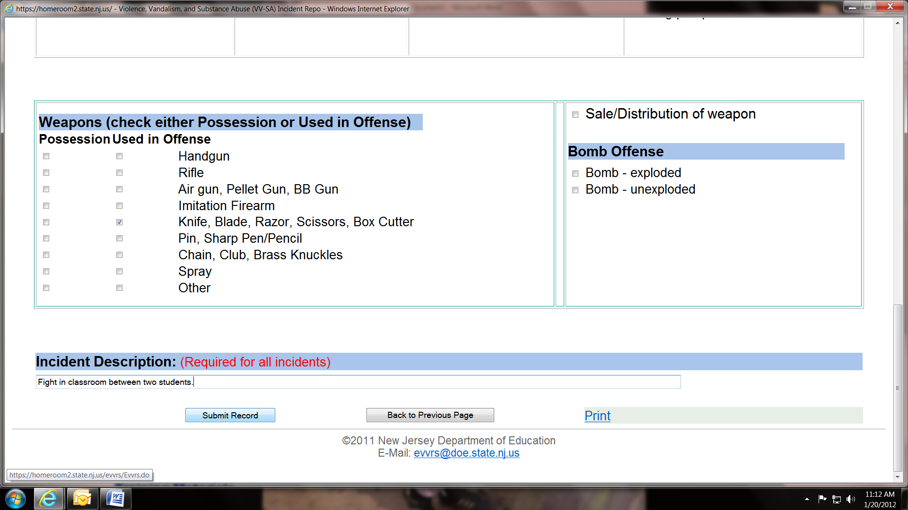

Slide 8
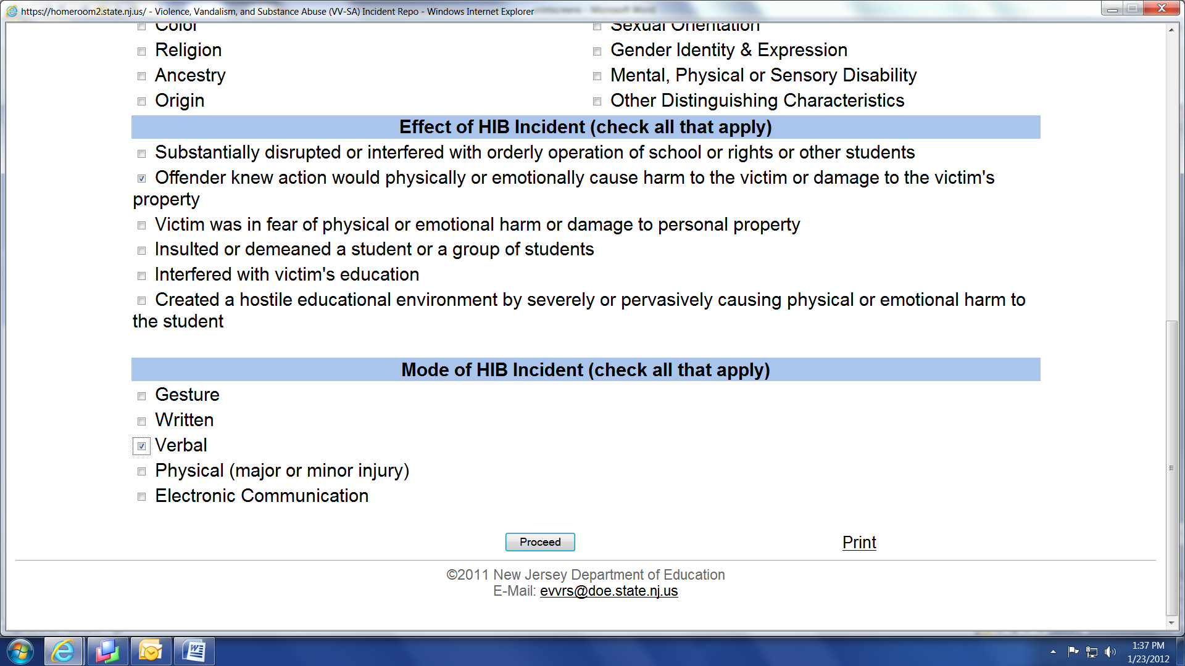

Slide 9
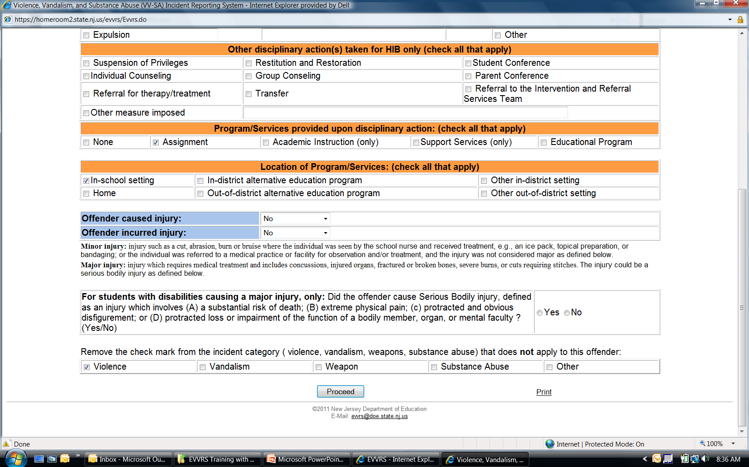

Slide 10
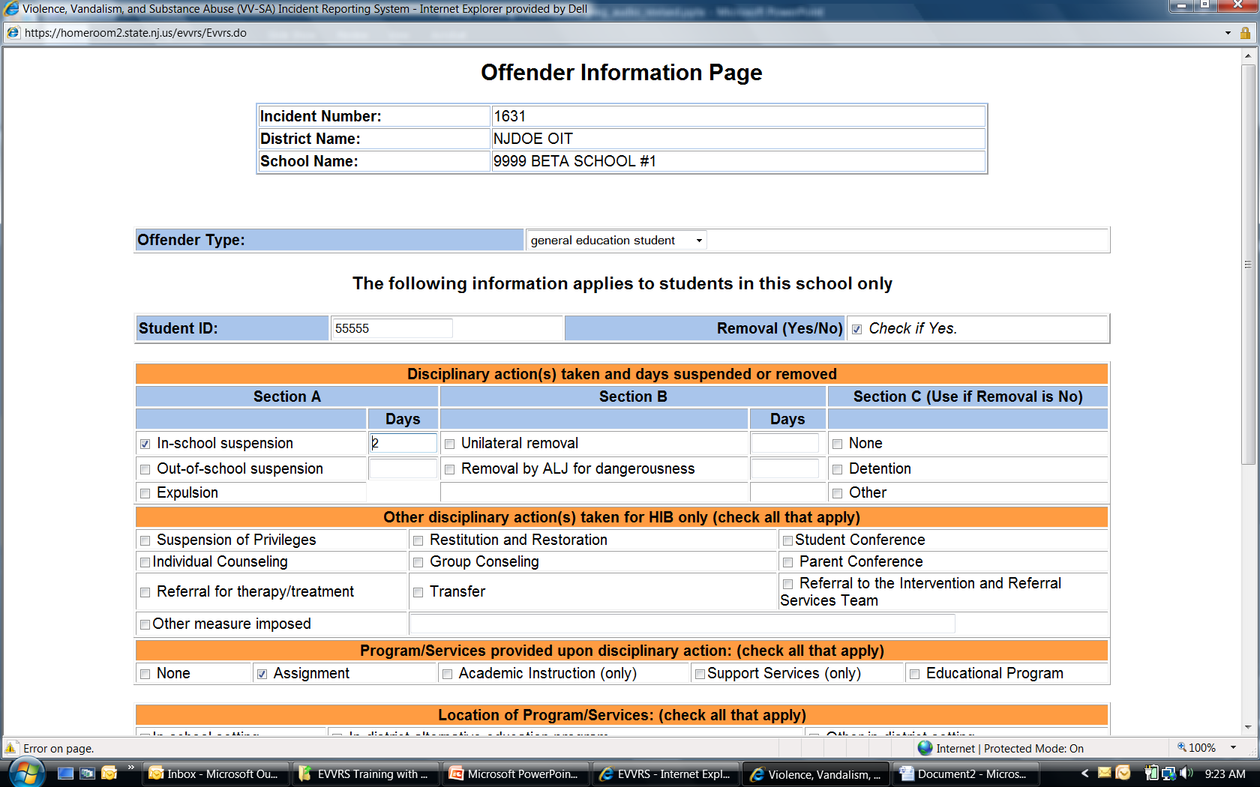

Slide 12
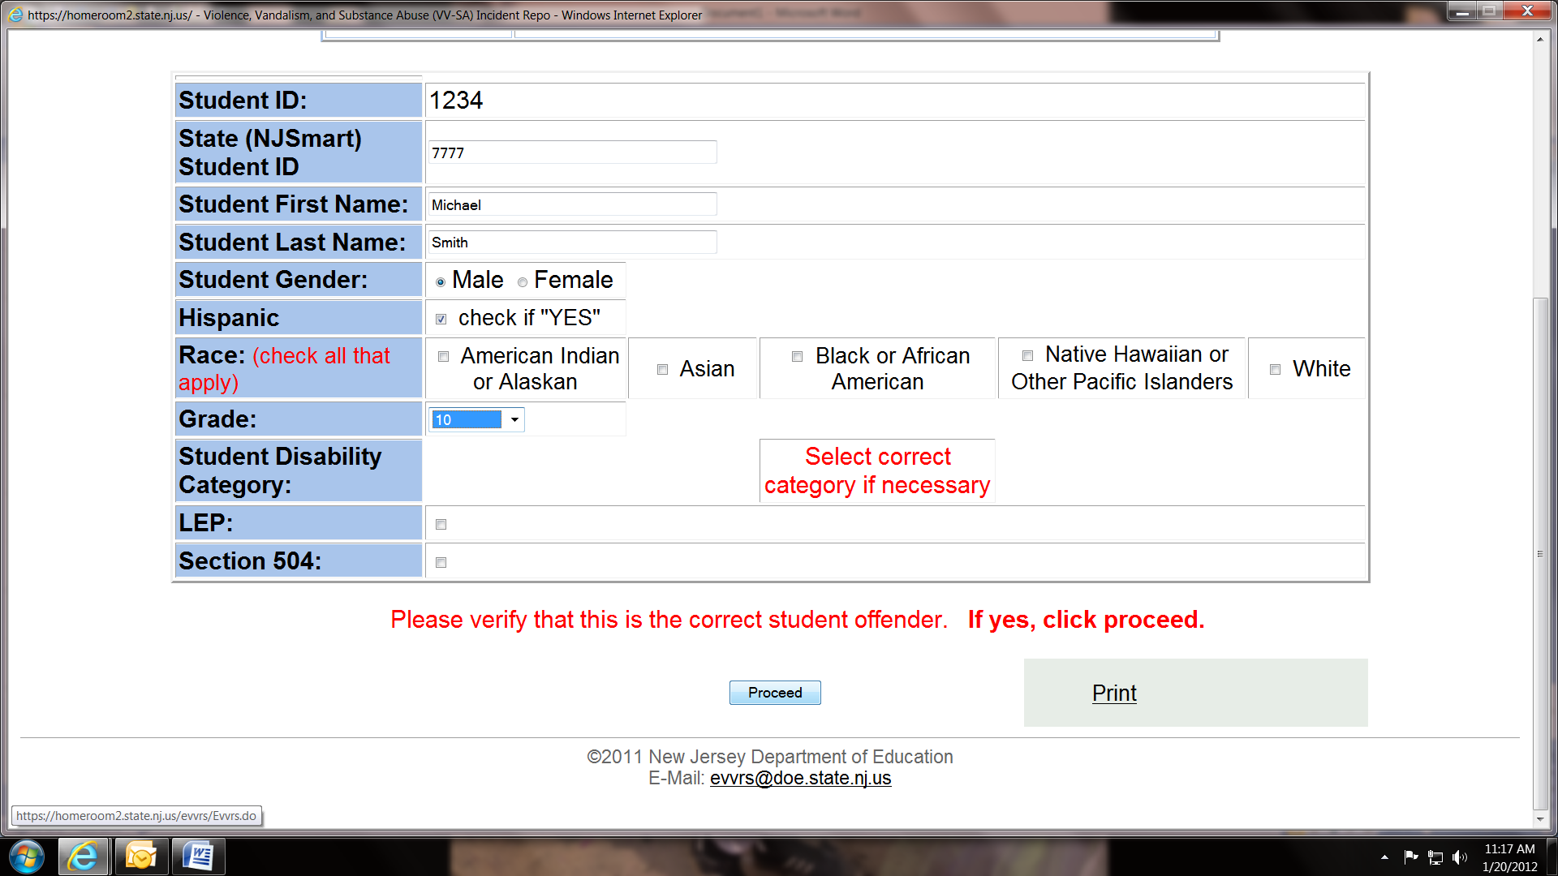

Slide 14
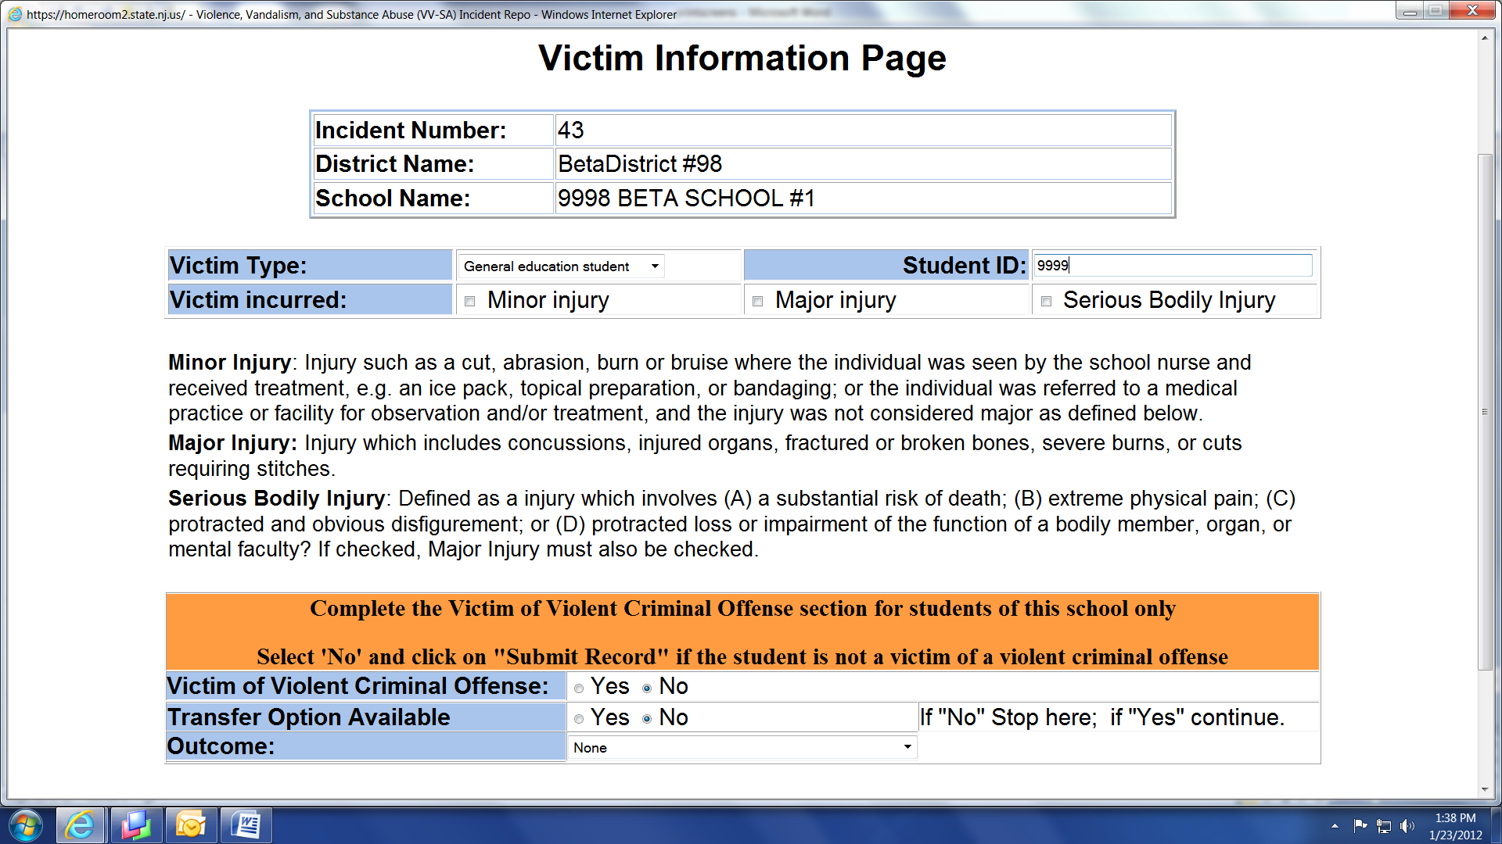

Slide 15
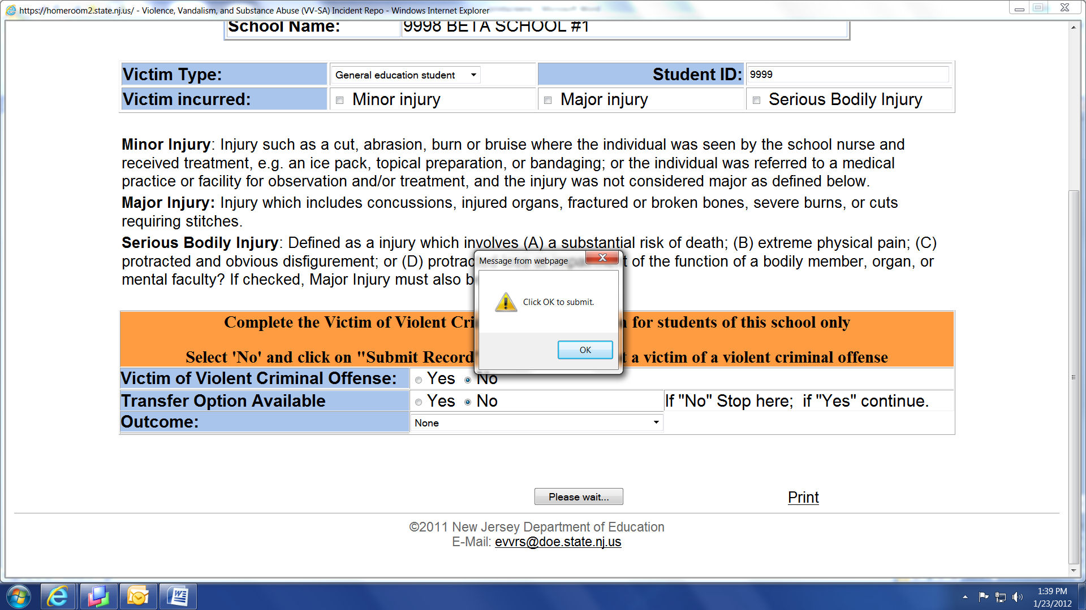

Slide 16
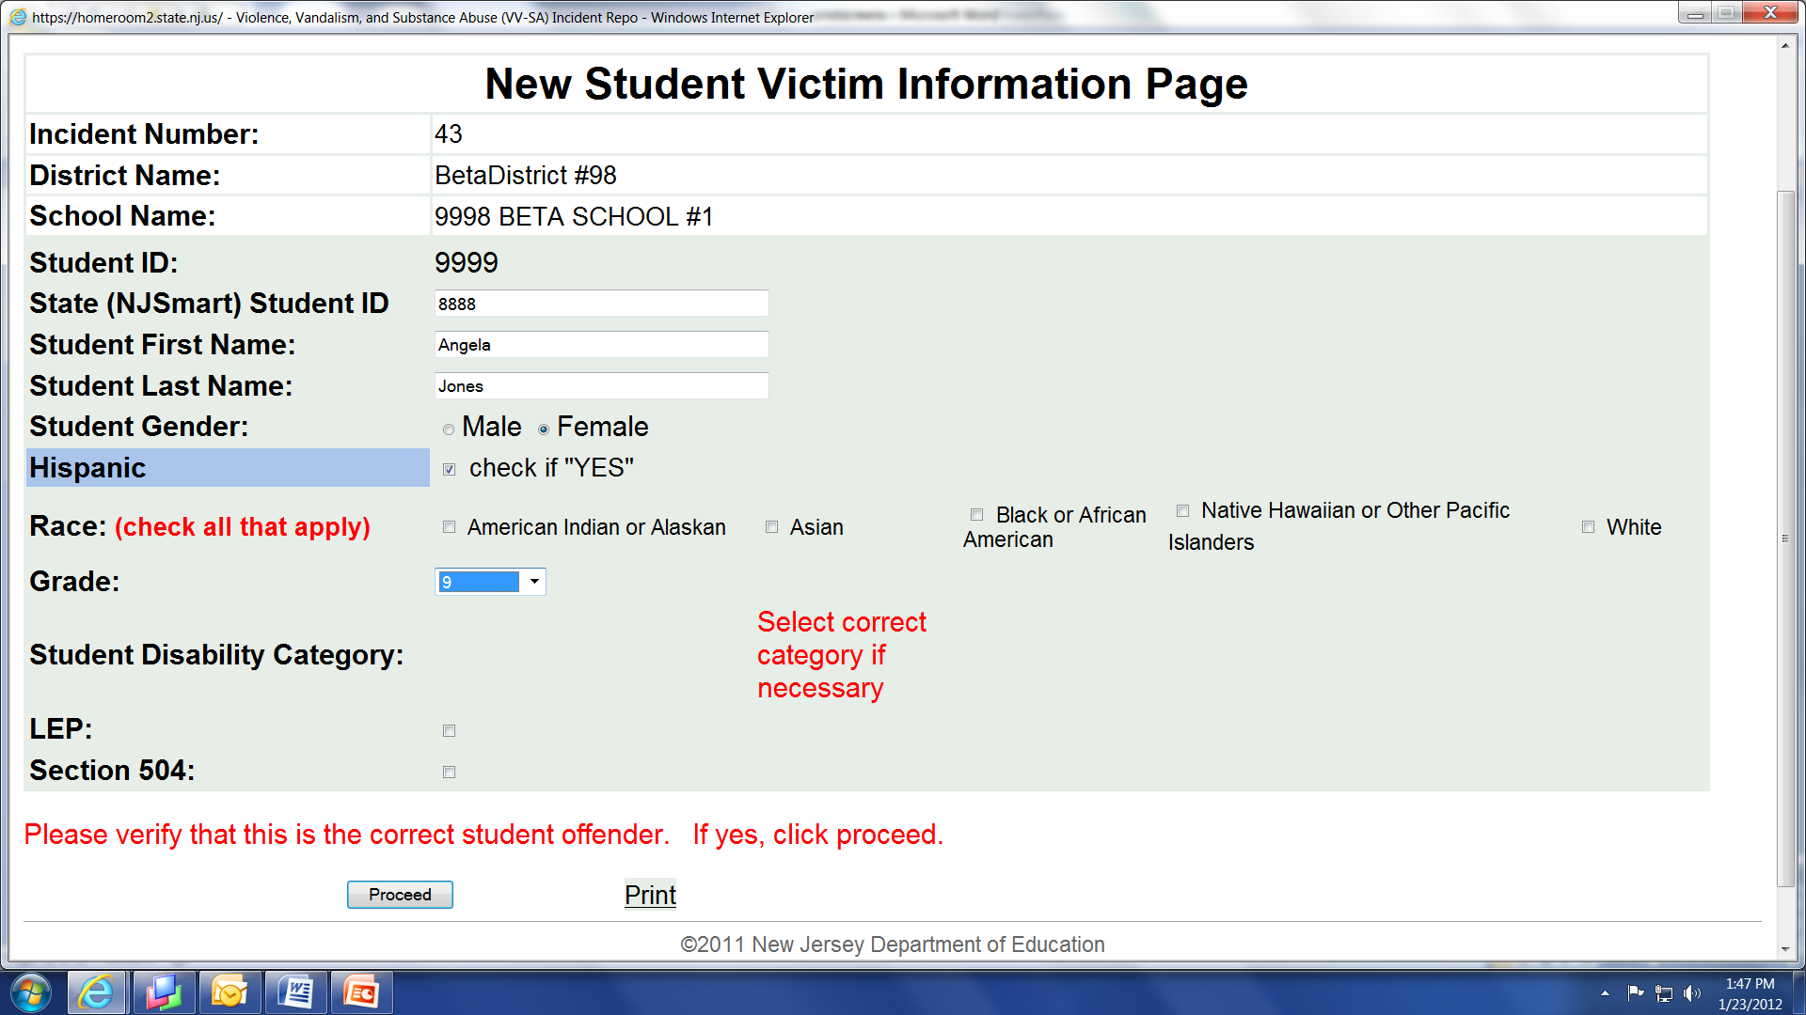

Slide 17
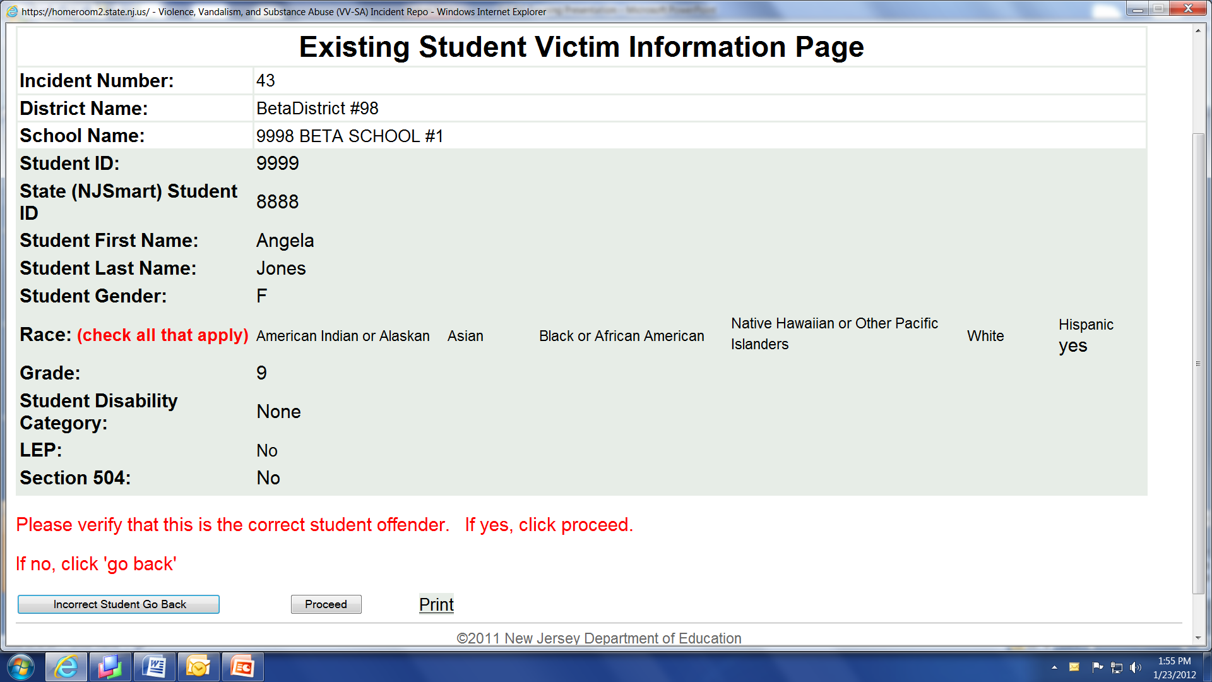

Slide 18
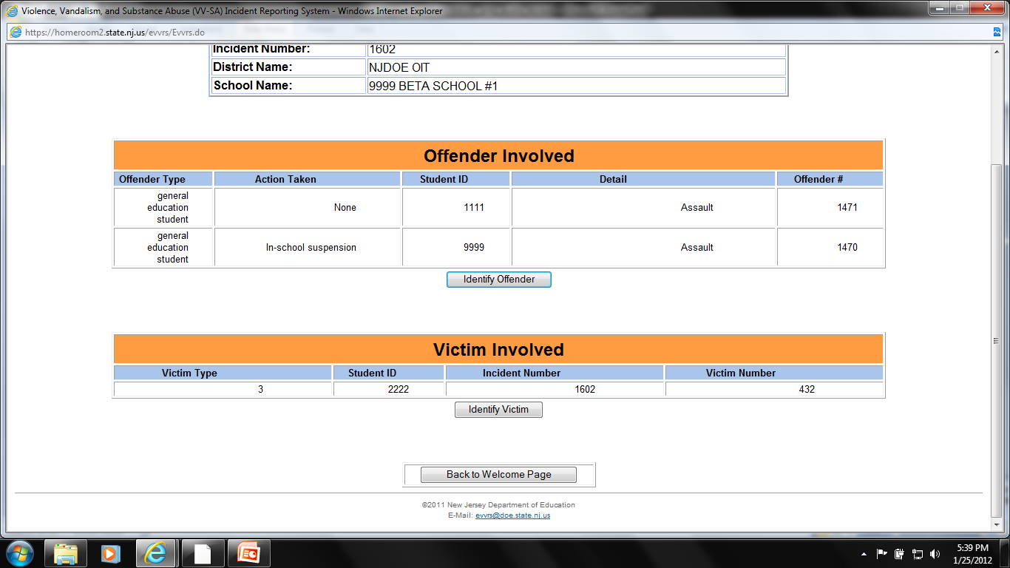

Slide 19
Reporting Suspensions of Students with Disabilities for Other Reasons

Slide 21
For login issues, please contact your district’s Web User Administrator. Each district’s Web User Administrator (usually the Business Administrator) establishes school and district-level user accounts for administrative and support staff that need access to the EVVRS.

Slide 23
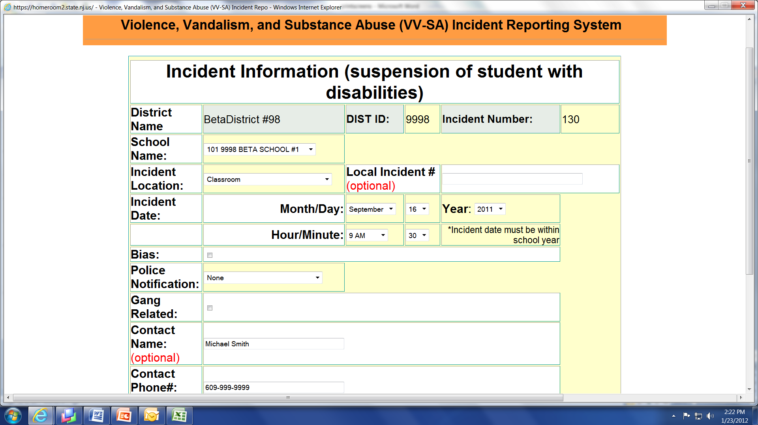
Suspension of Students with Disabilities for Other Reasons Incident
Information Data Entry Procedure
For each suspension of ½ day duration or longer

Slide 24
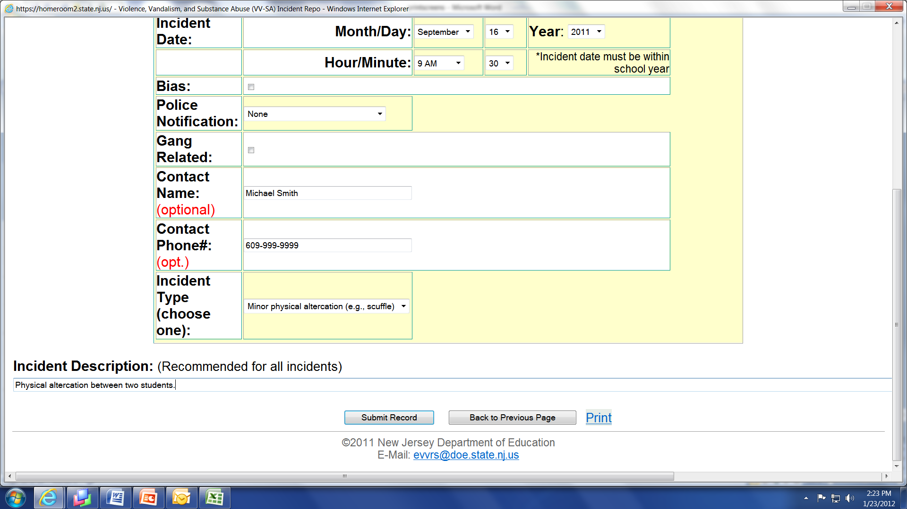

Slide 25
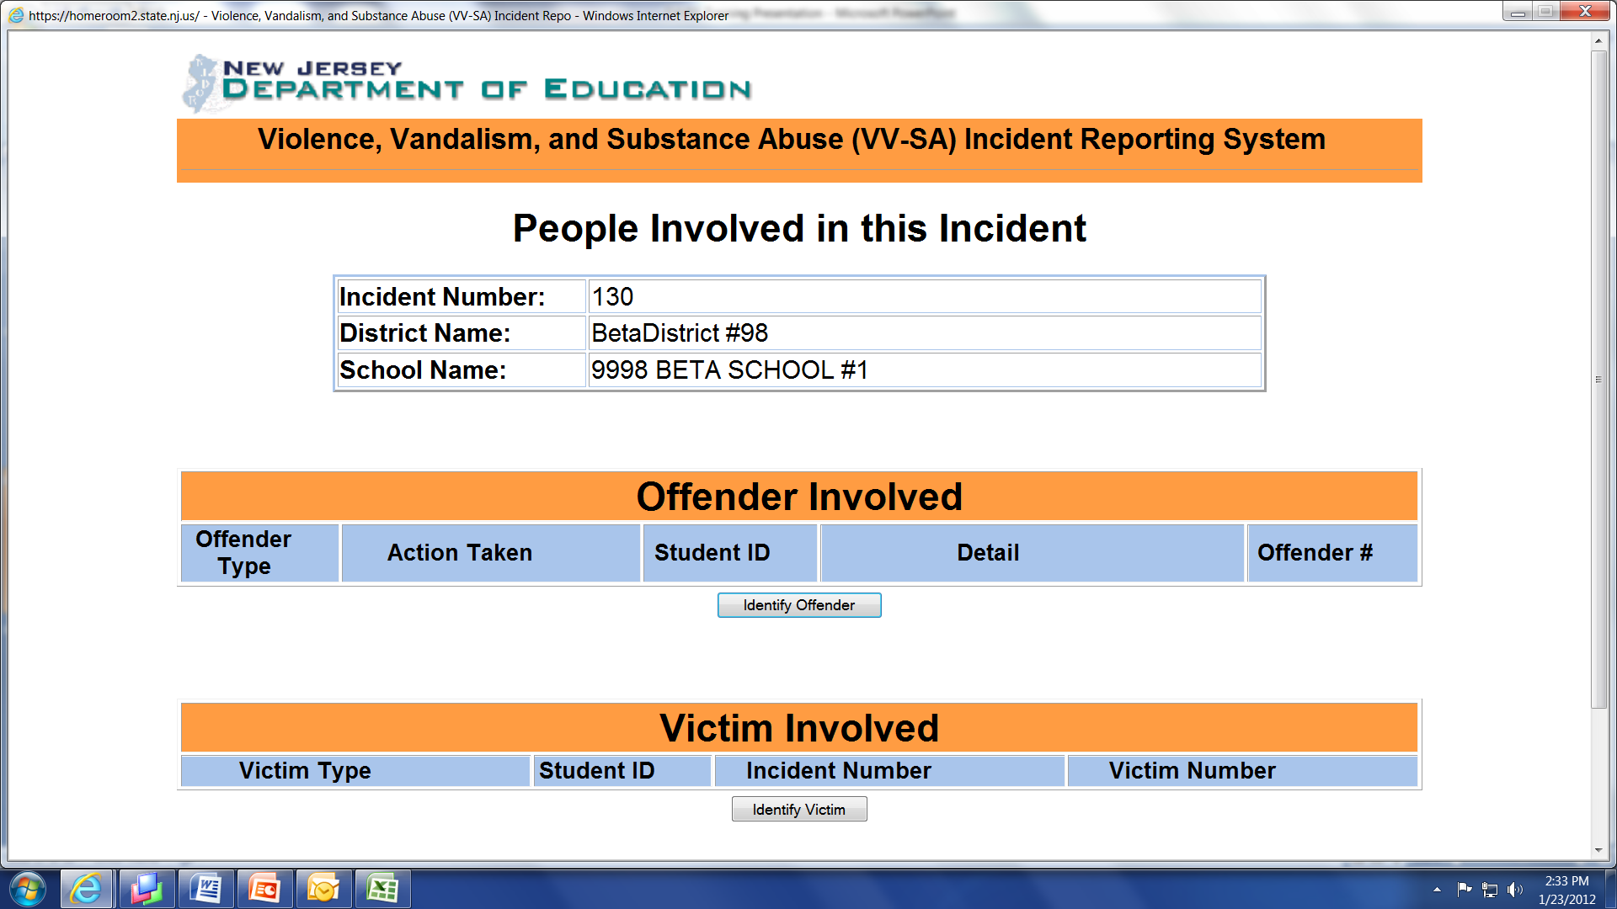
From here, follow the same steps for entering Offender and Victim Information that were described in the previous VV-SA section of this training module.

Slide 26
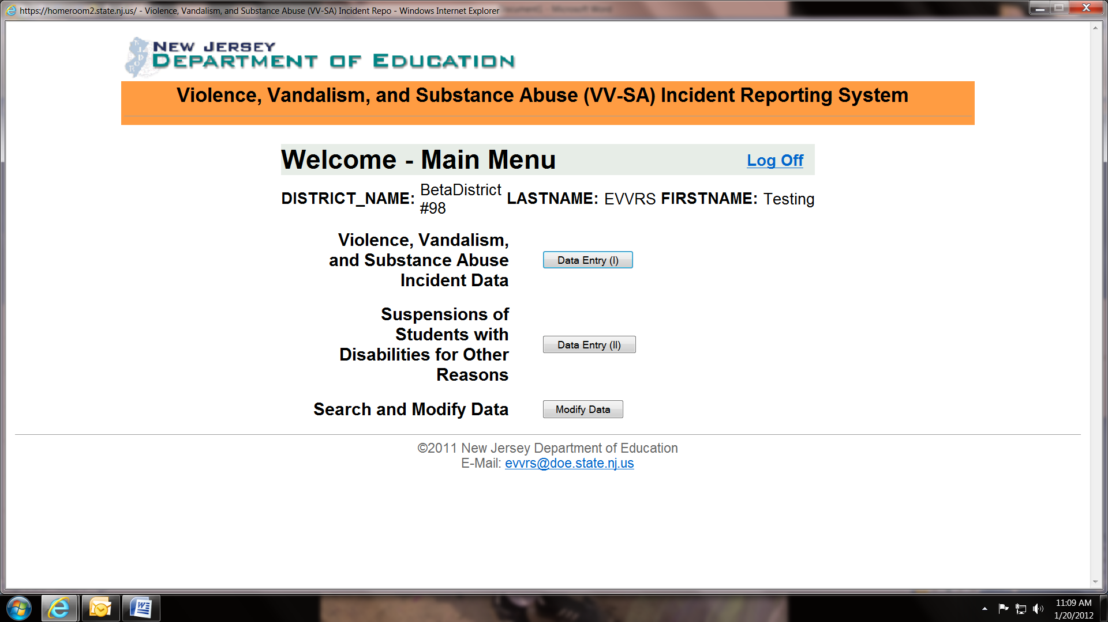

Slide 27
Editing Incident Reports

Slide 29
For login issues, please contact your district’s Web User Administrator. Each district’s Web User Administrator (usually the Business Administrator) establishes school and district-level user accounts for administrative and support staff that need access to the EVVRS.

Slide 32
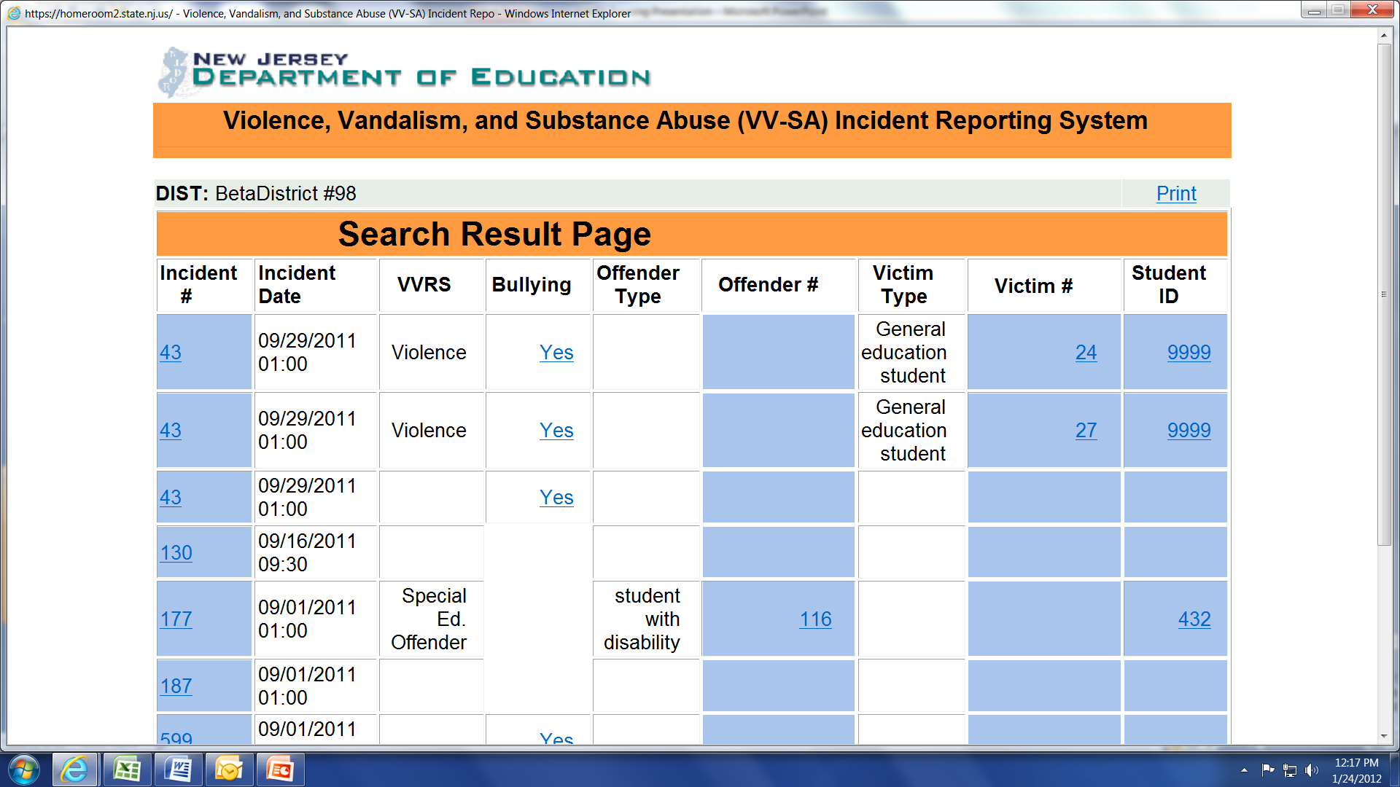

Slide 33
Deleting Incidents

Slide 35
For login issues, please contact your district’s Web User Administrator. Each district’s Web User Administrator (usually the Business Administrator) establishes school and district-level user accounts for administrative and support staff that need access to the EVVRS.

Slide 38
Report Period 1 Official Submission

Slide 40
For login issues, please contact your district’s Web User Administrator. Each district’s Web User Administrator (usually the Business Administrator) establishes school and district-level user accounts for administrative and support staff that need access to the EVVRS.

Slide 42
This step MUST be completed even if you have zero incidents to report!

Slide 44
EVVRS Support Contact Information:
evvrs@doe.state.nj.us
(609) 292-5935

